Slide 1
Data visualization
Kamarul Imran Musa
drkamarul@usm.my

Slide 2
Objectives of lecture
Understand
Understand why we need data visualization
Understand
Understand principles of data visualization
Know
Know types of data visualization/figures
Get
Get skills to perform data visualization

Slide 3
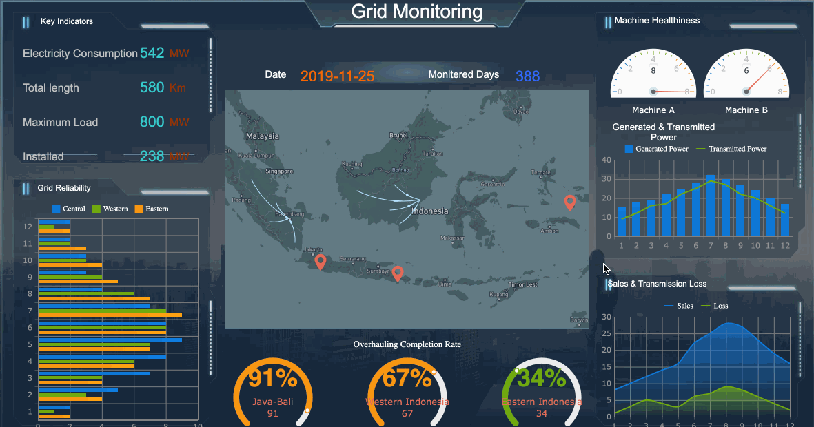
What are data visualization
https://towardsdatascience.com/top-7-trends-in-data-visualization-software-for-2019-c4b13e783844

Slide 4
Data visualization is
… the graphical representation of information and data.
This is done using visual elements like charts, graphs, and maps
Data visualization tools provide an accessible way to see and understand trends, outliers, and patterns in data.
Objective: data visualization tools and technologies are used to analyze massive amounts of information and make data-driven decisions.
https://www.tableau.com/learn/articles/data-visualization

Slide 5

Infographics and visualization
Infographics = presentation
Visualization = exploration

Slide 6
Why visualize?
Graphics
Simple
Clear
Has sufficient information
To tell stories with data
See what data have to say

Slide 7
How to visualize?
Source: Alberto Cairo. The Functional Art

Slide 8
How to visualize?
Unstructured information = reality
Data = records of observations
Knowledge = perception or meaning of data
Wisdom = deep understanding

Slide 9
More than numbers
Data can be boring
Statistics and data help you to look beyond data
Statistics is not pure analysis

Slide 10
What to acquire, do or have
Verified data
Reliable data
Clear, concise and nice graphics
Good
Points
Areas
Symbols
Colours
Annotation
Generate emotion

Slide 11
Visualization, Figures, Plots, Graphs
Data visualization :
graphical representation of information and data
Figures :
A figures is a visual presentation of results.
Come in the form of graphs, charts, drawings, photos, or maps.
They provide visual impact and can effectively communicate your primary finding.
Plot:
A plot is a graphical technique for representing a data set
Usually as a graph showing the relationship between two or more variables.
The plot can be drawn by hand or by a computer.
Graphs:
A graph is a picture designed to express words
Particularly the connection between two or more quantities.

Slide 12
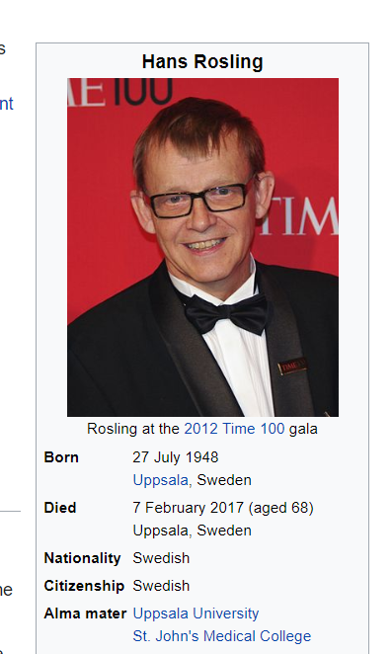
Visualization and animation
https://en.wikipedia.org/wiki/Hans_Rosling

Slide 13
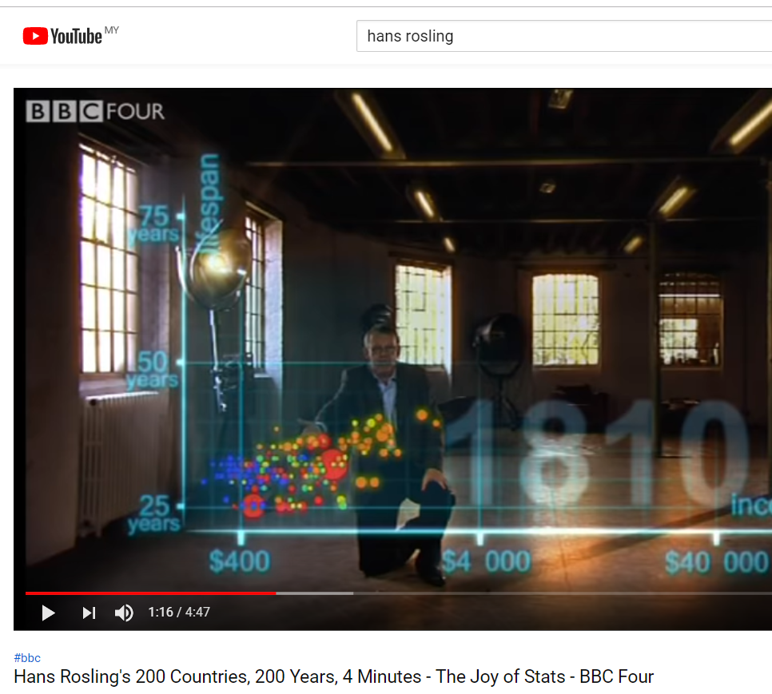
https://www.youtube.com/watch?v=jbkSRLYSojo

Slide 14

Minimalism and efficiency
Good visual design if
Well-designed presentation
Complex idea but presented with clarity, precision and efficiency
Gives viewers greatest number of ideas in the shortest time with the least ink

Slide 16
What should I look for?
Pattern
Relationship

Slide 17
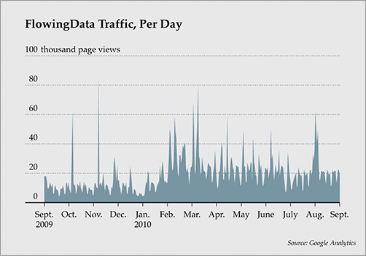
A) Pattern
Plot based on daily data
As time goes by
Bumpier graph
More fluctuations
Source: Visualize This, Figure 1-6

Slide 18
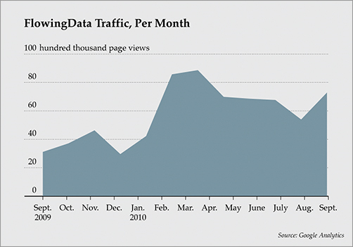
Same data, different plot
Based on monthly basis
You will get
Smoother plot

Slide 19
B) Relationship
But unlike statistics – relationship not for answering hypothesis

Slide 20
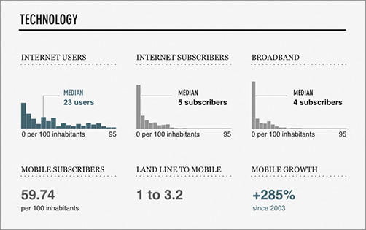
Compare distributions between groups
Source: visualize This Fig 1-8

Slide 21
What a graphic should contain
A graphic
Must present several variables
Should allow comparisons
Should help me organize the displayed data
Should make correlations or relationships evident

Slide 22
Examples
Easy to compare – sorted
Source: Alberta Cairo. The Function Art

Slide 23
Absolute vs relative terms
Venezuela and Bolivia are more militarized
Columbia is far ahead because war on narco-guerillas

Slide 24
Change through time, comparison and correlation
Time series chart, bar chart and scatter-plot chart

Slide 25
Data visualization, figures and plots
Data visualization is the graphical representation of information and data.
Represented by visual elements
Visual elements
charts, graphs, and maps
Objectives of data visualization tools
See and understand trends, outliers, and patterns in data.
https://www.tableau.com/learn/articles/data-visualization

Slide 26
Figures
the symbol for a number or an amount expressed in numbers
https://dictionary.cambridge.org/dictionary/english/figure

Slide 27
Plots
A plot is a graphical technique for representing a data set
For example, as a graph showing the relationship between two or more variables.
It can be drawn by hand or by a mechanical or electronic plotter.
Graphs are a visual representation of the relationship between variables
This is useful for humans who can then quickly derive an understanding which may not have come from lists of values.
https://en.wikipedia.org/wiki/Plot_(graphics)

Slide 28
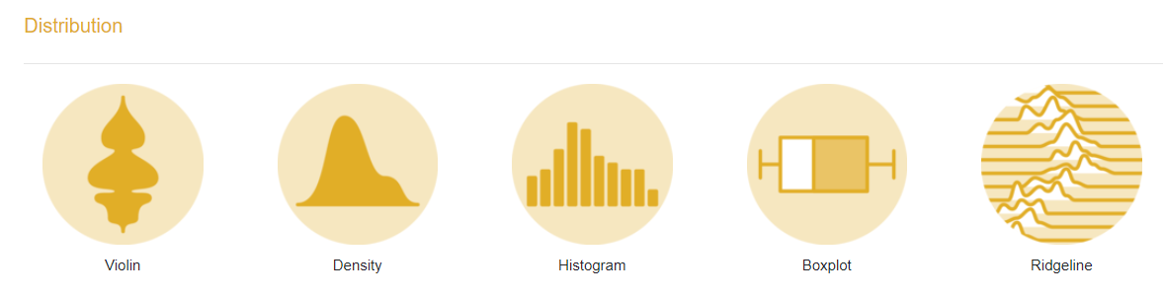
Types of graphs
https://www.r-graph-gallery.com/

Slide 29
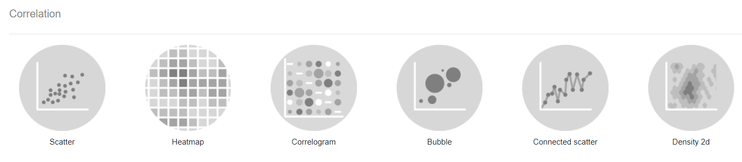
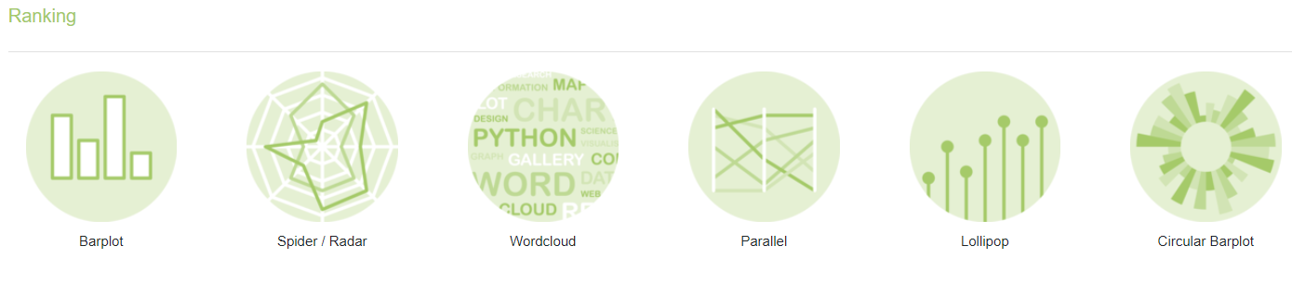
https://www.r-graph-gallery.com/

Slide 30
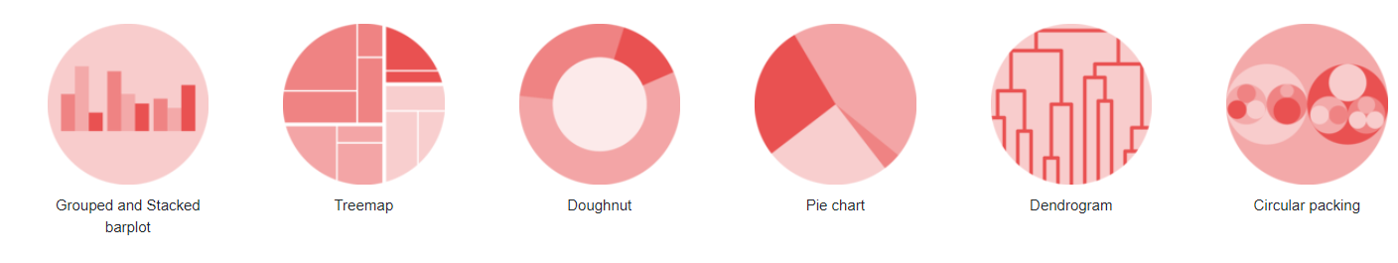
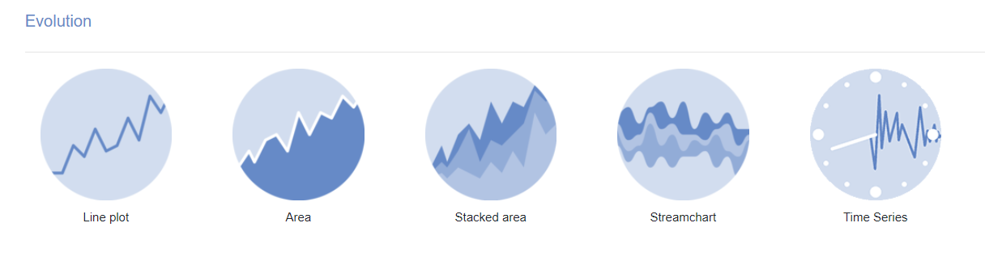
https://www.r-graph-gallery.com/

Slide 31
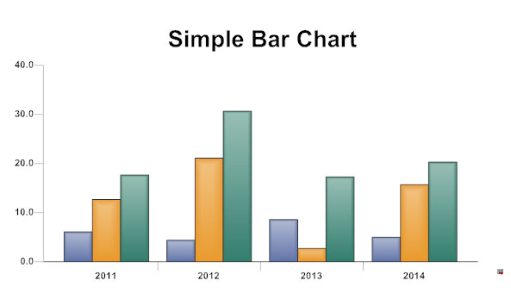
Different types of graphs
Bar chart :
is a chart or graph that presents categorical data
It has rectangular bars with heights or lengths proportional to the values that they represent.
https://www.smartdraw.com/bar-graph/

Slide 32
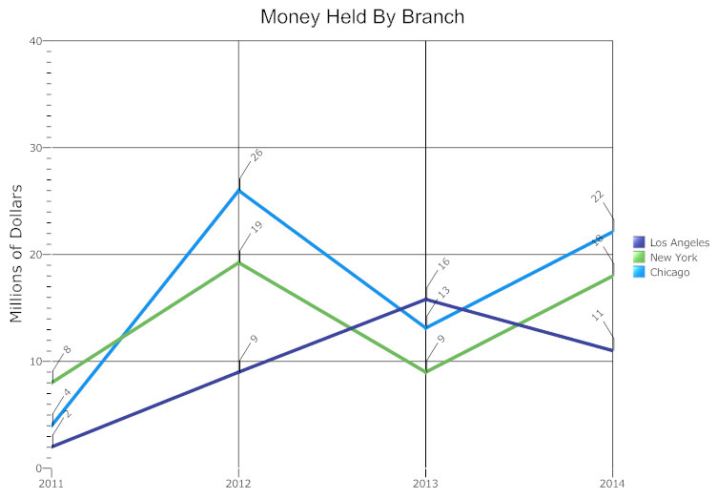
Line graphs :
A line graph, also known as a line chart
It is a type of chart used to visualize the value of something over time.
For example, a finance department may plot the change in the amount of cash the company has on hand over time.
https://www.smartdraw.com/line-graph/

Slide 33
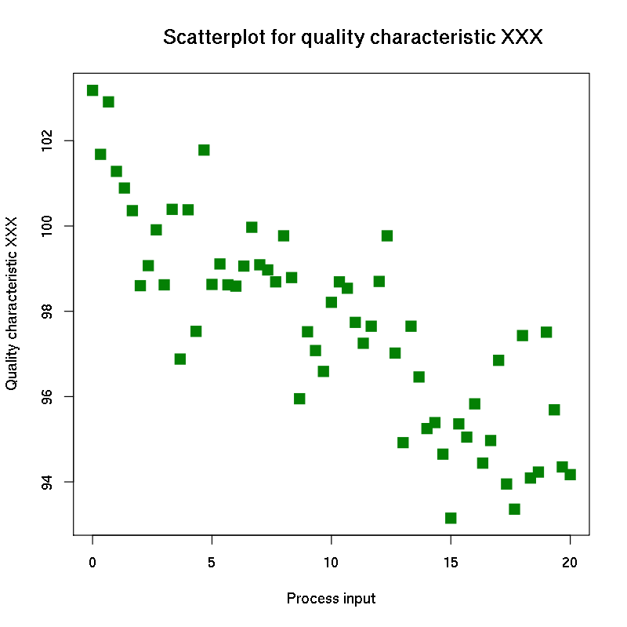
Scatter plot :
A scatter plot (also called a scatterplot, scatter graph, scatter chart, scattergram, or scatter diagram) is a type of plot or mathematical diagram using Cartesian coordinates
It displays values for typically two variables for a set of data.
https://en.wikipedia.org/wiki/Scatter_plot

Slide 34
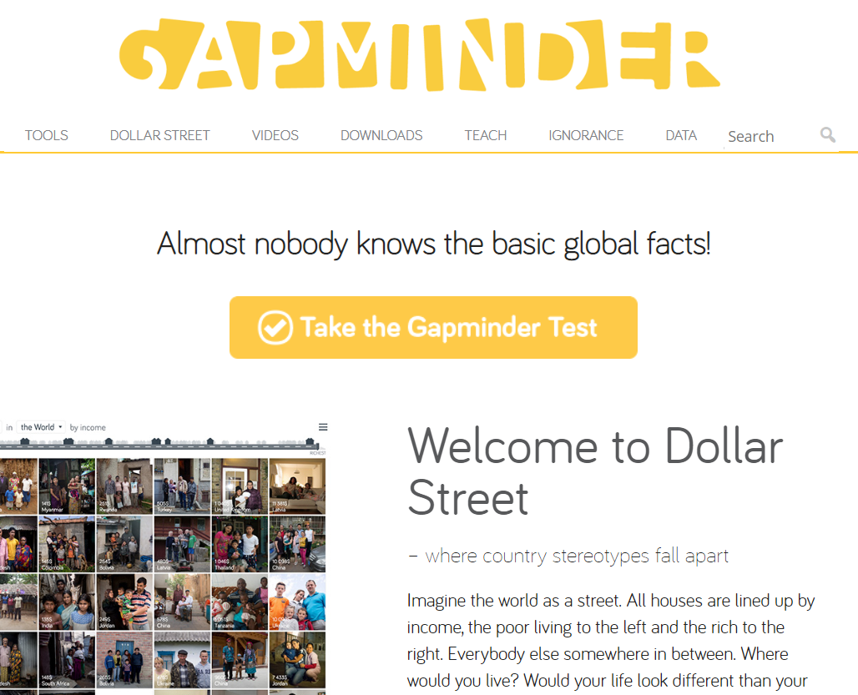
Communicating data visualization
https://www.gapminder.org/

Slide 35
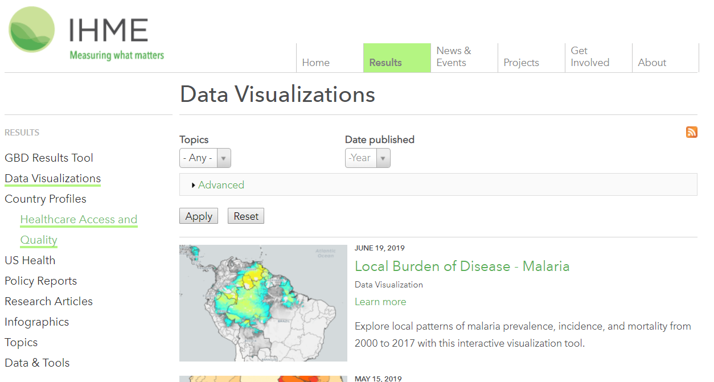
http://www.healthdata.org/results/data-visualizations

Slide 36
References
Edward R Tufte. The Visual Display of Quantitative Information Graphics.

Slide 37
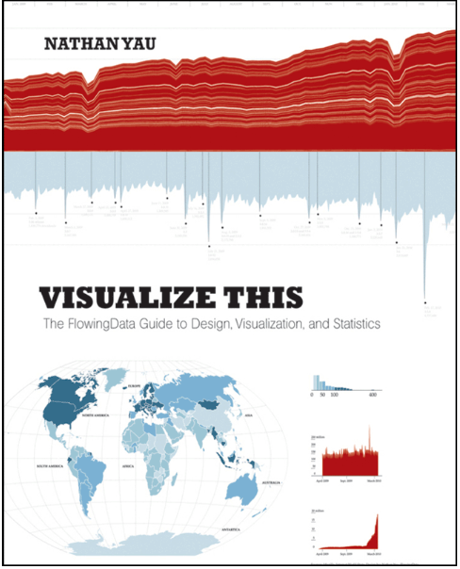
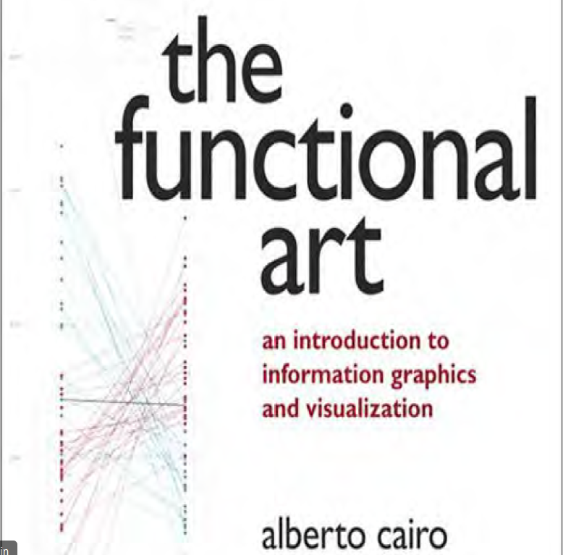

Slide 38
References
https://r-graphics.org/
https://r4ds.had.co.nz/data-visualisation.html
http://www.ggplot2-exts.org/gallery/

